Slide 1
SPIDER
Gesture Controlled Hexapod
Archit Sharma, Sai Pranay, Samyu Kamtam

Slide 2
Contents
Problem statement
Features
About the solution
Product instructions
Advantages and disadvantages
Design
Workflow
Mathematics
Sensors, actuators and design
Prototype
Practical Overview
Related work
Innovative features and Unique selling proposition
Cost analysis
Next steps and Conclusion

Slide 3


Problem Statement
The global personal mobility devices market size was valued at USD 10.58 billion in 2022 and is anticipated to expand at a compound annual growth rate (CAGR) of 6.8% from 2023 to 2030.

Slide 4
Features
Gesture based control system
Operated using a hand-mounted controller with accelerometers and flex sensors.
Intuitive gestures mapped to different movements.
Hexapod movement with high stability
Capable of navigating uneven terrains, stairs, and slopes.
Continuous support from multiple legs ensures safe operation.
User centric device
Customizable gestures and movements tailored to individual needs.
Compact, wearable control interface for easy operation.
Creative functionality
Enables expressive movements such as dance, promoting creative expression for users.
Encourages social interaction and boosts user confidence.

Slide 5
Safety features and instructions
Safety Features:
Hardware Safety Features:
⁠Protection Against Overvoltage and Overcurrent
Software Safety Features:
Predefined Shutdown Position
Invalid Input Handling and Noise Filtering
Motor Control Safety
Instantaneous Shutdown Procedure:
When a thumbs down gesture is made by the user - the robot immediately shuts down and can only be used if restarted.
Guidelines for safe and accurate usage:
Correct Finger Placement
Avoid Rapid or Forceful Movements
Maintain Clear Operating Environment
Regular System Calibration

Slide 6
Advantages
Disadvantages
Enhanced mobility
New opportunities for expression (Ex: Dance)
Stability and redundancy
Customization (tailorable to individual needs - speed, stability and movement range)
User-friendly (natural gesture control makes it easy to learn and is more subtle)
Complexity (Design and control system)
Cost
Energy consumption
Scalability
Market acceptance

Slide 7
Design

Slide 8
Working
Actuate
Servo states outputted as PWM signals to servos for actuation
03
Sense
Using flex sensors for finger movement
Using Memsic accelerometer for tilt measurement in x and y direction
01
02
Sequence
Converting analog (flex sensors) and digital (accelerometer) input sensor values into servo states by mapping it to different position sequences

Slide 9
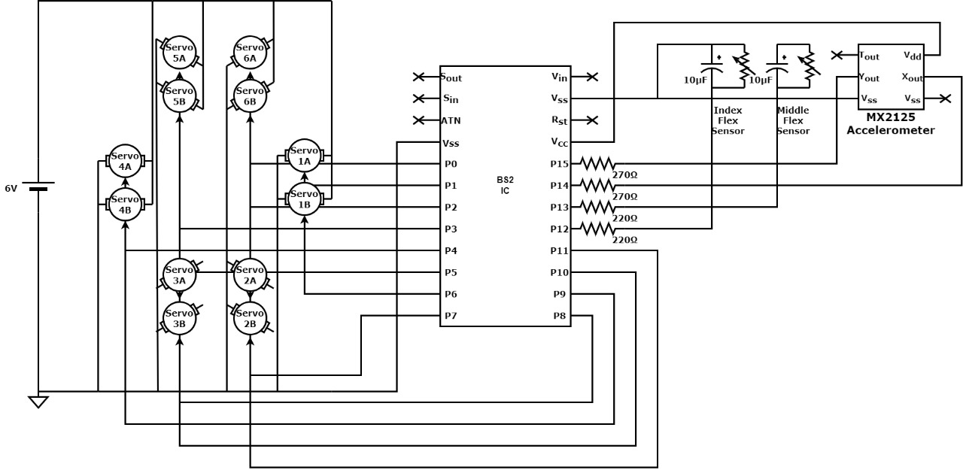
Electronic circuit diagram

Slide 10
Mathematics for BS2
Servo control
Speed control:
If speed*direction = 0 then θ = θ + speed
If speed*direction = 1 then θ = θ - speed
Squats:
If θ = θmin or θmax then reverse speed
Initialise all legs in same direction
Swagger:
If θ = θmin or θmax then reverse speed
Initialise legs in opposite direction
 | Min value | Max value
θ | -90 | 90
θn | 0 | 15
PWM | 500 | 1000

Slide 11
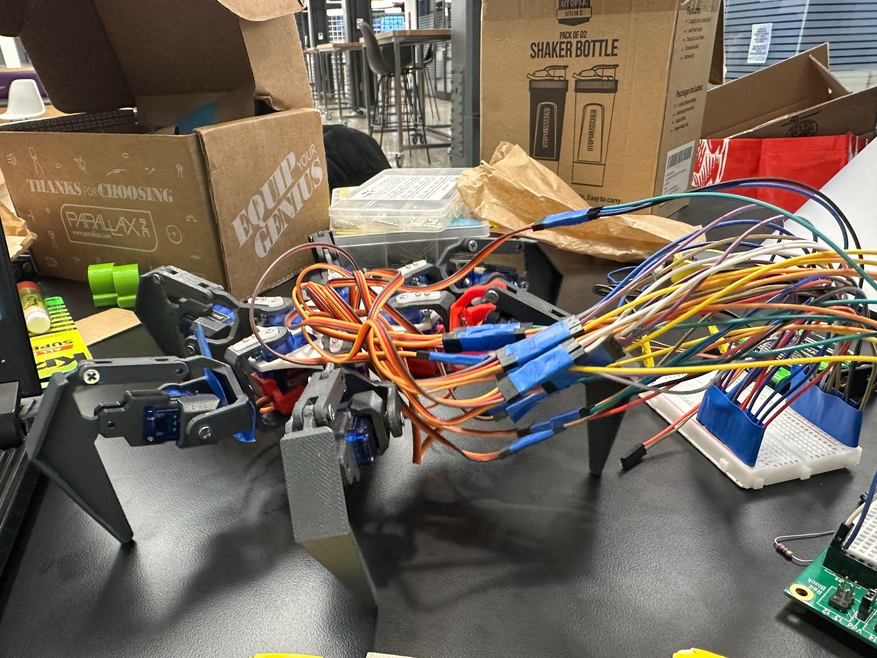
Sequences of Hexapod movement - Squats
Up/Down

Slide 12
Sequences of Hexapod movement-Swagger
Left Tilt
Right Tilt

Slide 13
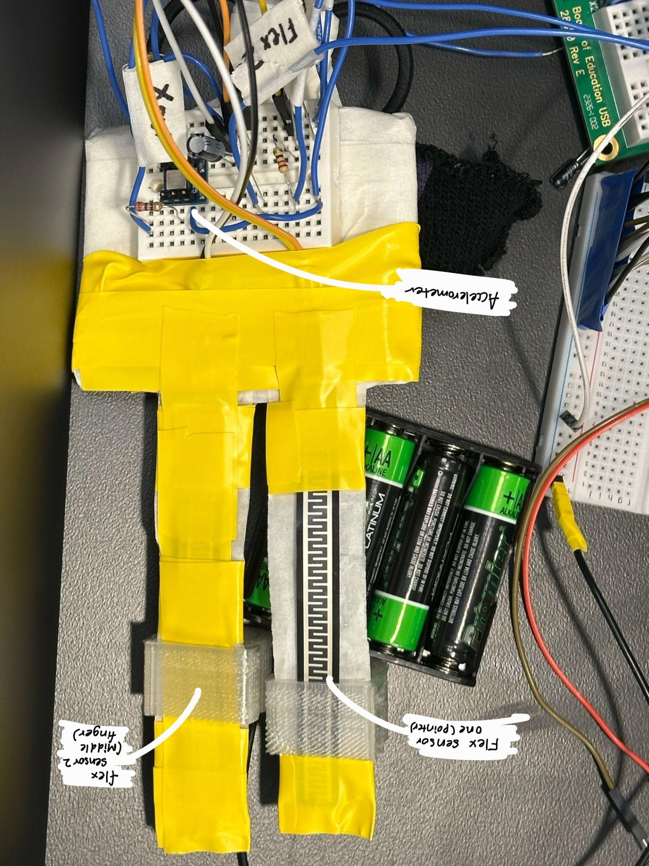
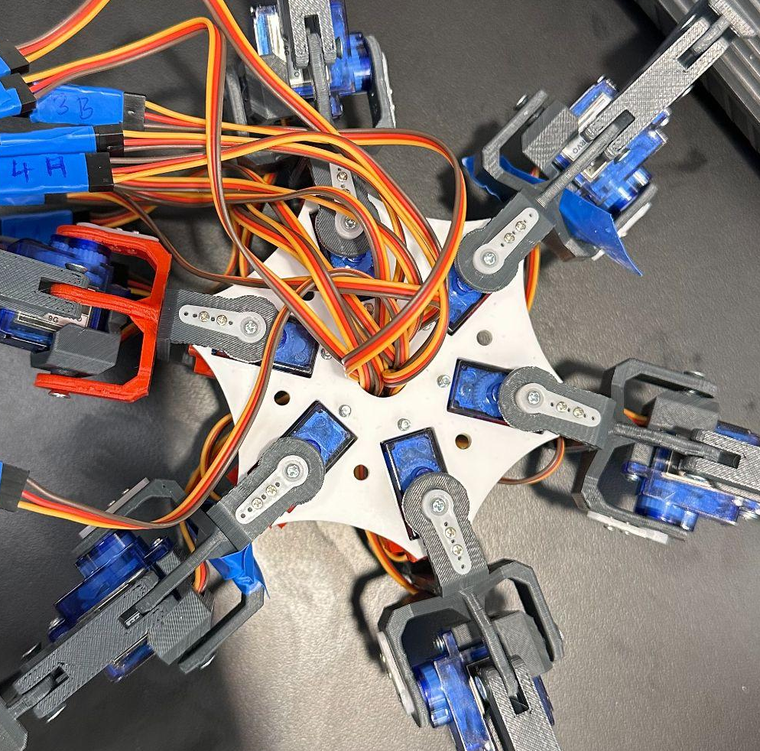
Sensors, Actuators and Design
Sensors:
Flex sensors:
Direct feedback on finger bending
Straightforward interaction with microcontroller by using input mapping
MX2125 Memsic accelerometer:
Measures tilt and acceleration
Reliable and sensitive for real-time control
Actuator:
9g micro servo
Lightweight and compact
Adequate torque
Design:
Gesture control
Leverages natural hand movements
Reduces cognitive load
Hexapod
12 DOF
Stability and flexibility

Slide 14
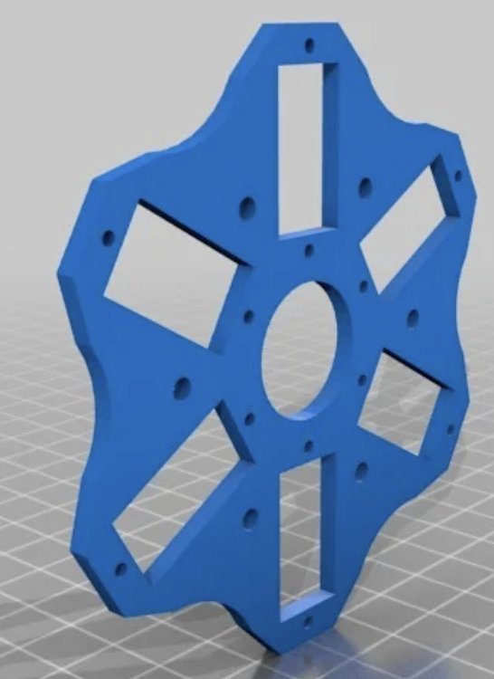
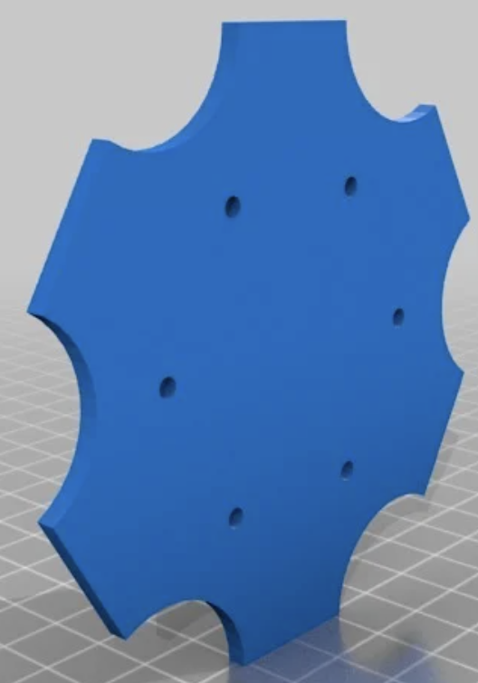
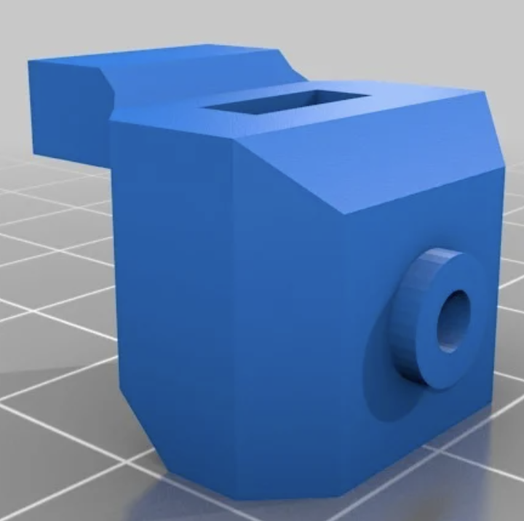
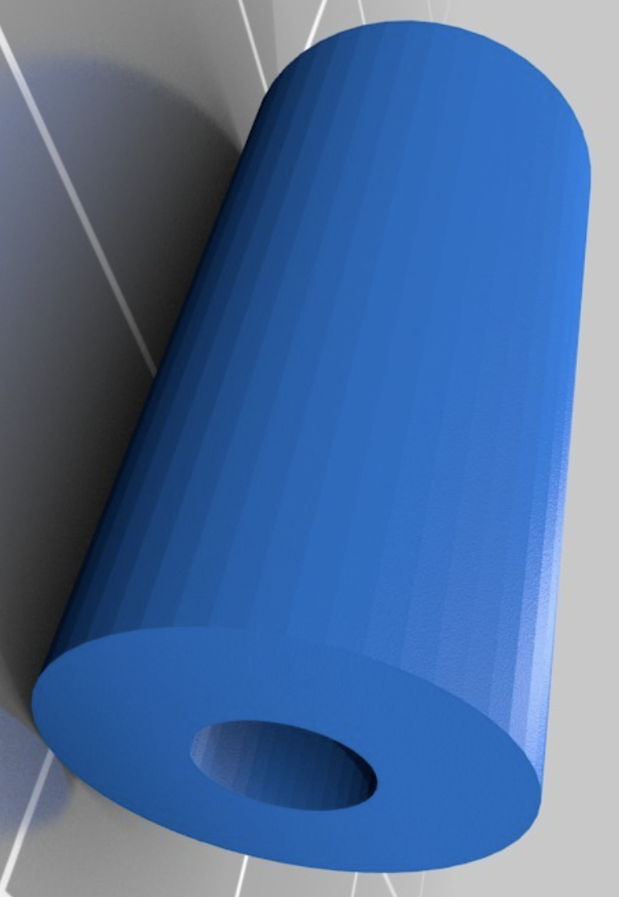
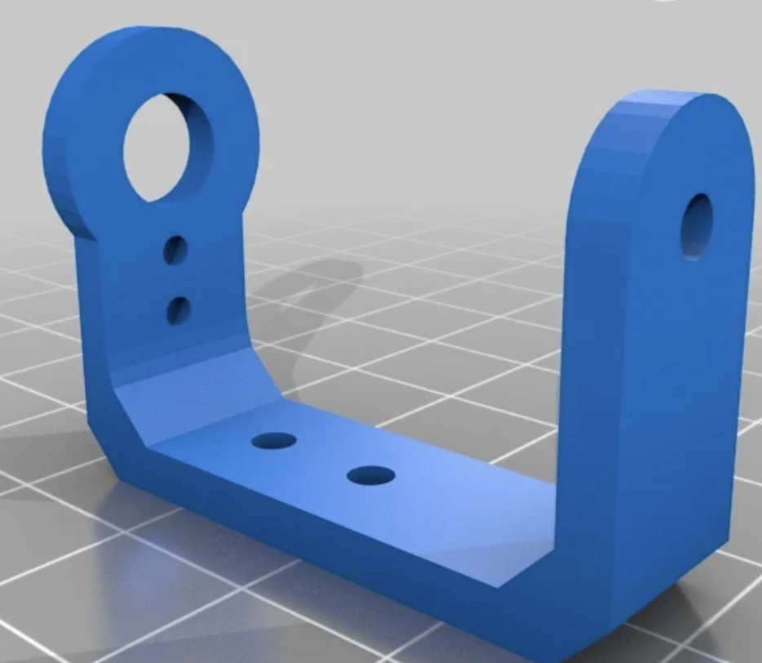
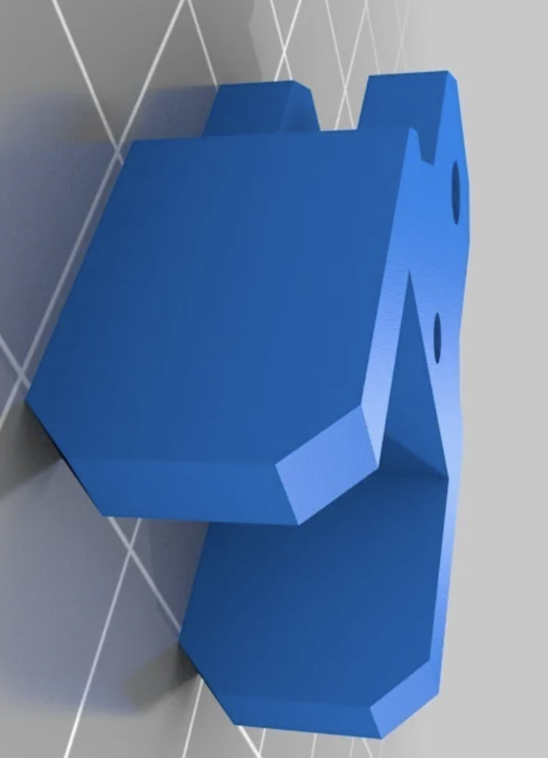
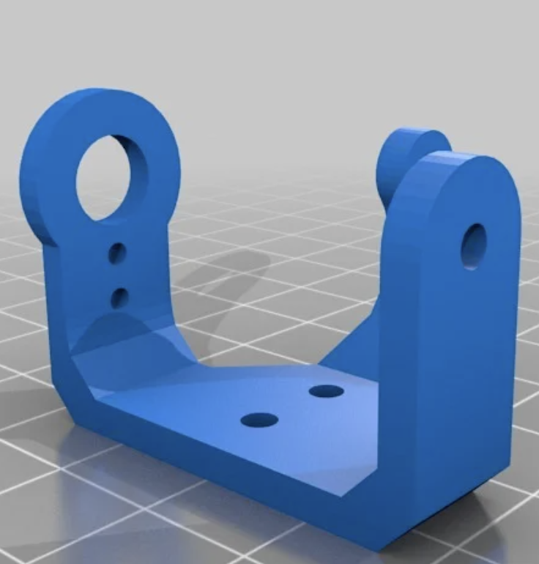
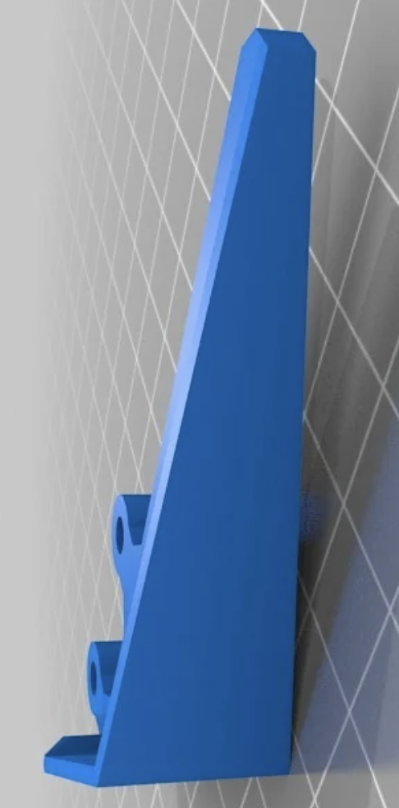
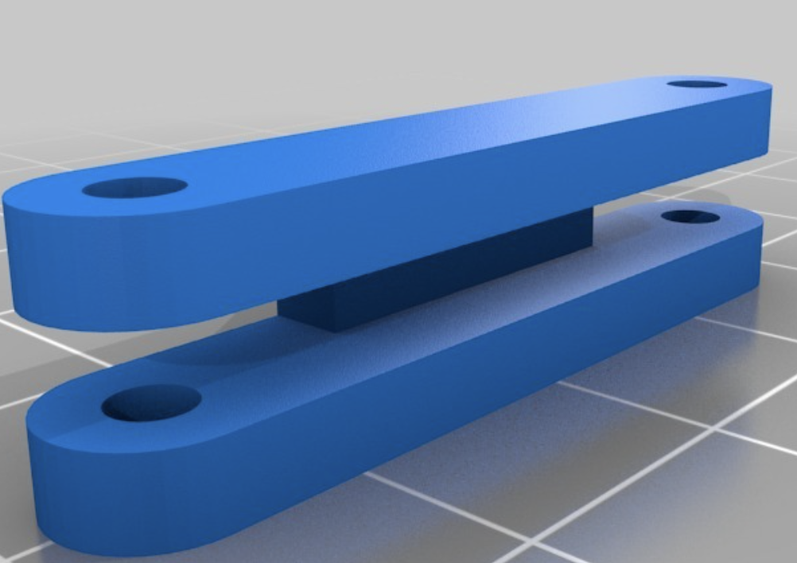
Mechanical Design - Hexapod
Supports
Hexapod
Lower base
Upper base
Servo Bracket
Leg Components

Slide 15
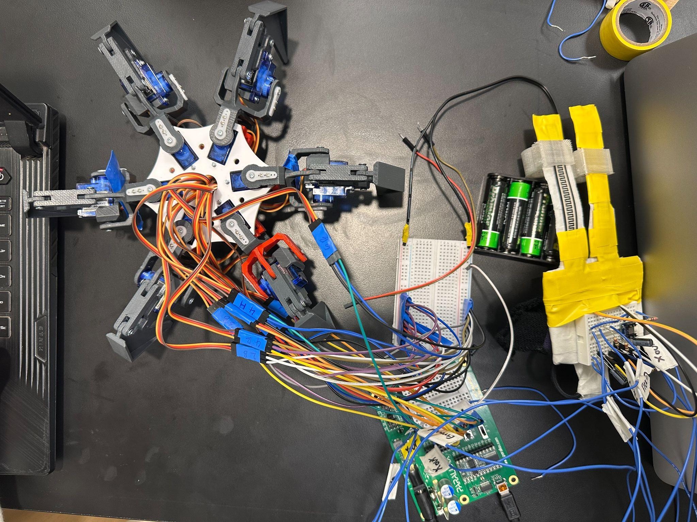
Final set up

Slide 16
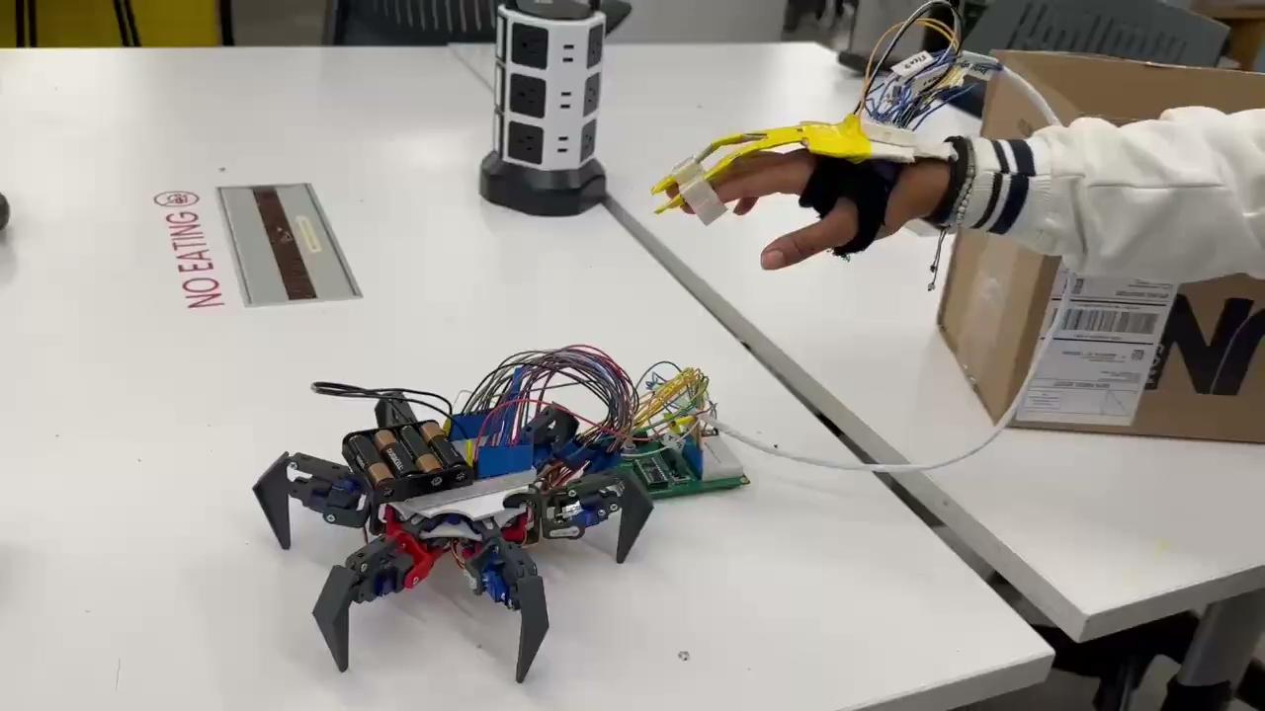
Prototype

Slide 17
Practical Overview

Slide 18
Related work
Gesture-Controlled Hexapods Using Wireless Technology
Employing devices like the ATOM ESP32 Pico and IMU modules to detect and interpret hand movements.
Intuitive Control: Gesture-based systems enable natural interaction with robots, reducing the learning curve for users.
Wireless Operation: The elimination of physical connections increases user mobility and operational flexibility.
Limitations such as susceptibility to signal interference.
Challenges in achieving precise gesture recognition have been reported, affecting system reliability and responsiveness.
Intel’s Gesture-Controlled Spiderbots
Controlled through wearable devices equipped with accelerometers and gyroscopes.
Seamless Integration: Wearable controllers provide an intuitive and ergonomic interface for real-time robot interaction.
Real-Time Responsiveness: The system ensures immediate execution of user commands, enhancing the overall experience.
Drawbacks include a limited gesture set, restricting the range of functionalities.
Potential latency in gesture recognition, which may compromise real-time performance.

Slide 19
Innovative Features and Unique Selling Proposition
Innovative Features
Gesture based control for hexapod
User centric design
Unique Selling Proposition:
Expressive mobility
Customisable gestures

Slide 20
Cost analysis
Cost analysis for mass production
Cost component | Cost
Materials | $2,000
Actuators and sensors | $800
Manufacturing Labour | $500
Tooling | $100
Compliance and testing | $300
Marketing and distribution | $200
Shipping and Packaging | $100
Overhead | $300
Total | $4300
Advanced Wheelchair market price | $4365
Component | Cost
BS2 with Board of education | $100
9g Servo motors | $45
3D print | $14
Flex sensors | $20
MX2125 accelerometer | $15
Miscellaneous | $15
Total Prototype Cost | $210
Bill of Materials

Slide 21
Next Steps
Working walk and turn sequences using inverse kinematics and dynamics
Make an 18 DOF hexapod with hand end effector for enhanced assistance
Live size with strong actuators for load bearing

Slide 22
Conclusion
Revolutionize assistive technology
Enhance mobility and self-expression for individuals with disabilities
Solution combines stability and flexibility of hexapod with user friendly gesture based controls
Challenging with respect to system complexity and energy efficiency

Slide 23
References
https://onlinelibrary.wiley.com/doi/full/10.1002/rob.22186 https://pmc.ncbi.nlm.nih.gov/articles/PMC9589936/
https://acrome.net/post/what-are-hexapod-robots-used-for
https://www.popsci.com/intels-ceo-unleashes-gesture-controlled-spiderbots/
https://www.thingiverse.com/thing:1021540#google_vignette
https://www.grandviewresearch.com/industry-analysis/personal-mobility-devices-market
https://www.cdc.gov/ncbddd/disabilityandhealth/infographic-disability-impacts-all.html
Basic Analog and Digital Version 1.3
BASIC Stamp Syntax and Reference Manual Version 2.2
What’s a Microcontroller? Version 3.0

Slide 24
Thank you.

